Slide 1
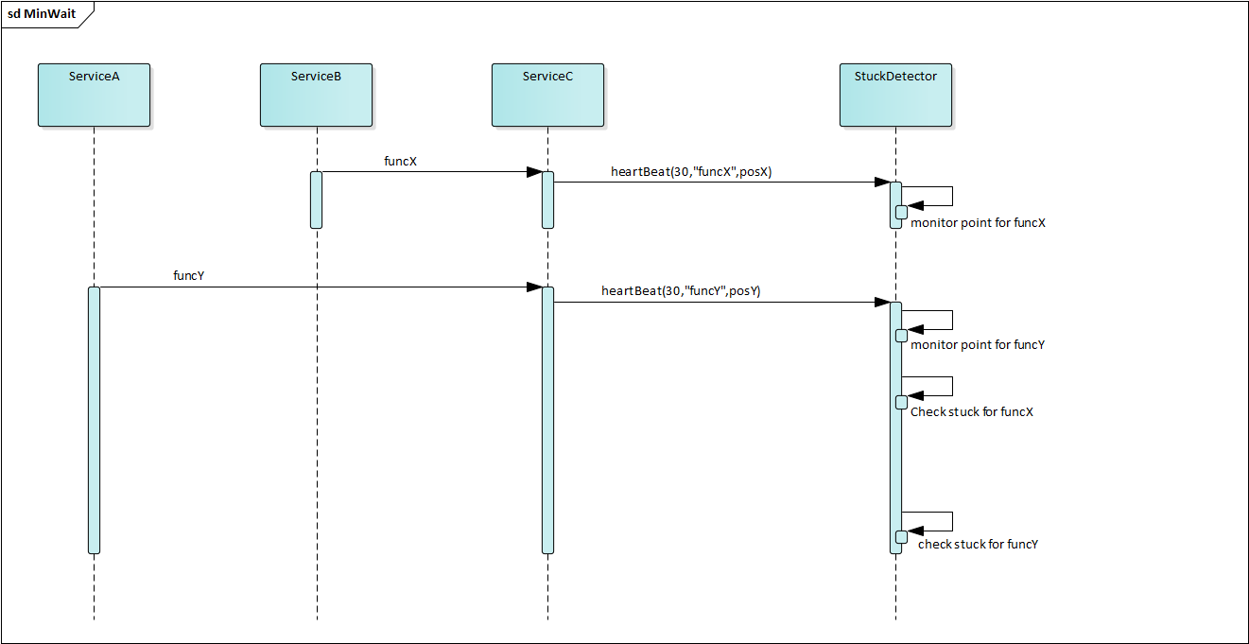
lastkick_X
30 sec
lastkick_Y
limit_X
30 sec
minWait
limit_Y

Slide 2
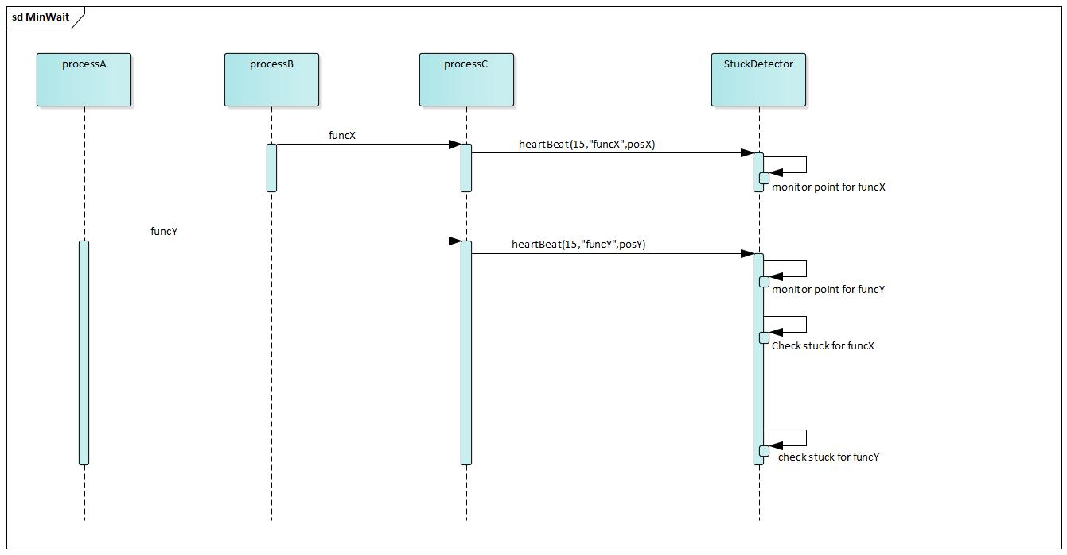
lastkick_X
30 sec
lastkick_Y
limit_X
30 sec
minWait
limit_Y

Slide 3
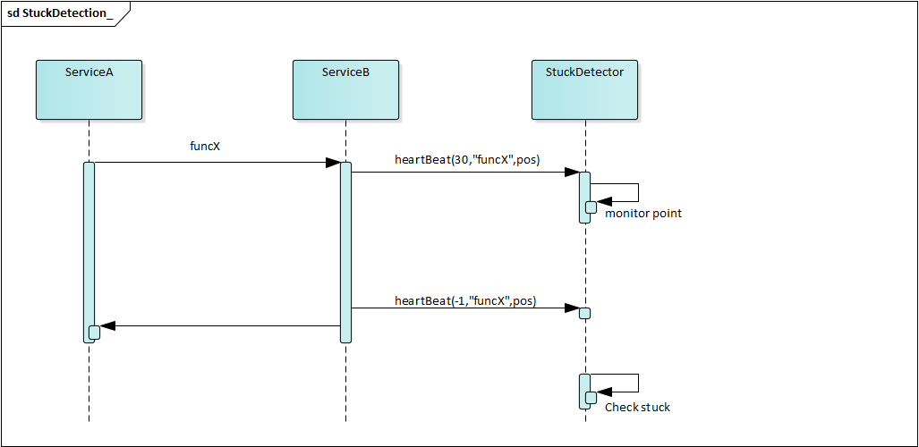
30 sec
no stuck detection

Slide 4
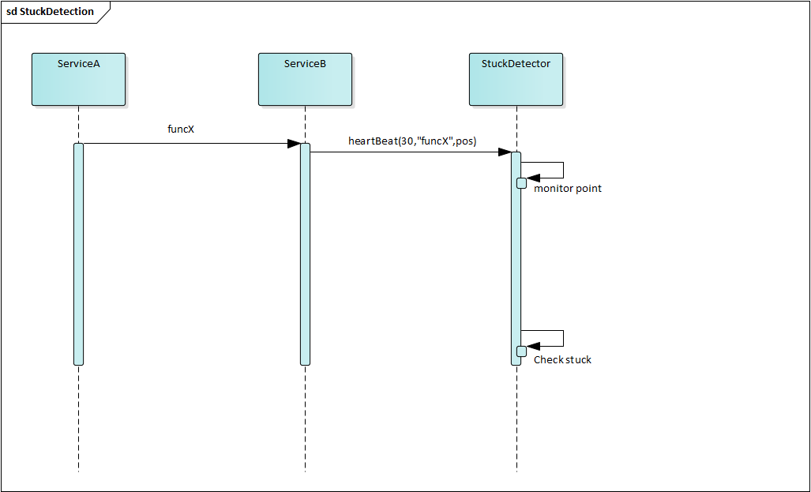
stuck detection
30 sec
heartBeat(-1,”funcX”,pos)

Slide 5
TracerInfor
timeout | 30
Lastkick | 2
limit | 32
funcName | funX
positition | Filename1::line1
duration
key1=(fileName1,line1,tid1)
key2=(fileName2,line2,tid2)
timeout | 30
Lastkick | 10
limit | 42
funcName | funY
position | Fiename2::line2
duration
stuckDetector map

Slide 6
CurrentTime=2 sec
hearbeat(timeout=30,filename=“fileA.cpp”, line=12,func=“funX”,tid=1000 )
CurrentTime=8 sec
hearbeat(timeout=-1,filename=“fileA.cpp”, line=12,func=“funX”,tid=1000 )
timeout | 30
Lastkick | 2
limit | 32
funcName | funX
position | fileA.cpp:12
duration
timeout | -1
Lastkick | 8
limit | 7
funcName | funX
position | fileA.cpp:12
duration | 6 (sec)
key1=“fileA.cpp:12:1000”
key1=“fileA.cpp:12:1000”

Slide 7
CurrentTime=2 sec
hearbeat(timeout=30,filename=“fileA.cpp”, line=12,func=“funX”,tid=1000 )
CurrentTime=35 sec
key1=“fileA.cpp:12:1000”
timeout | 30
Lastkick | 2
limit | 32
funcName | funX
position | fileA.cpp:12
duration
Stuck detection!
timeout > 0 and currentTime(35sec) > limitTime(32)
one entry stuck if:
timeout > 0 && currentTime > limitTime
currentTime
kick heartbeat start
limit time
time
client must kick heartbeat end during limit time

Slide 8
check Stuck
minWait_
time

Slide 9
Synchronous
Worker Thread 1
Worker Thread 1
Worker Thread 1
<<get>>
<<get>>
<<get>>
Queueing
Job Queue
<<put>>
Job Dispatcher
<<deliverTask>>
StuckDetectorManager
<<heartBeat>>
ConnectionManager
<<heartBeat>>
client
Asynchronous
socket
StuckController
TraceDataManager

Slide 10
Synchronous
Worker Thread 1
Worker Thread 2
Worker Thread 3
<<get>>
<<get>>
<<get>>
Queueing
Job Queue
<<put>>
Producer 1
<<deliverTask>>
Asynchronous
Job Dispatcher
Producer 1
Producer 1

Slide 11
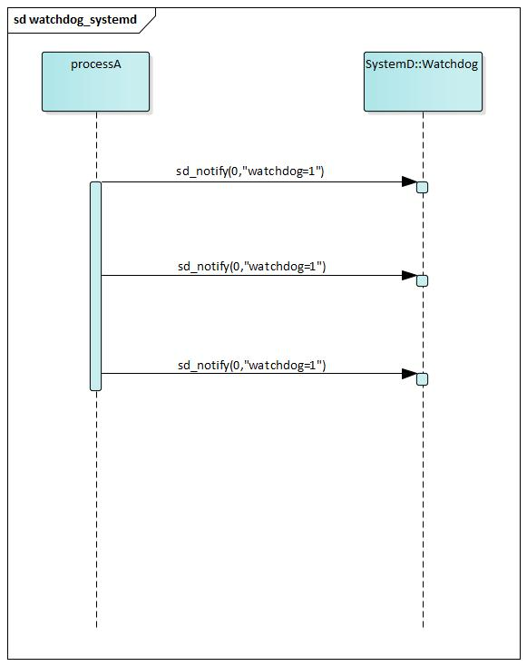
regularly ping duration
(predefined)
Stuck state
sd_notify(0,”watchdog=1”)
Kill(SIGABRT)

Slide 12
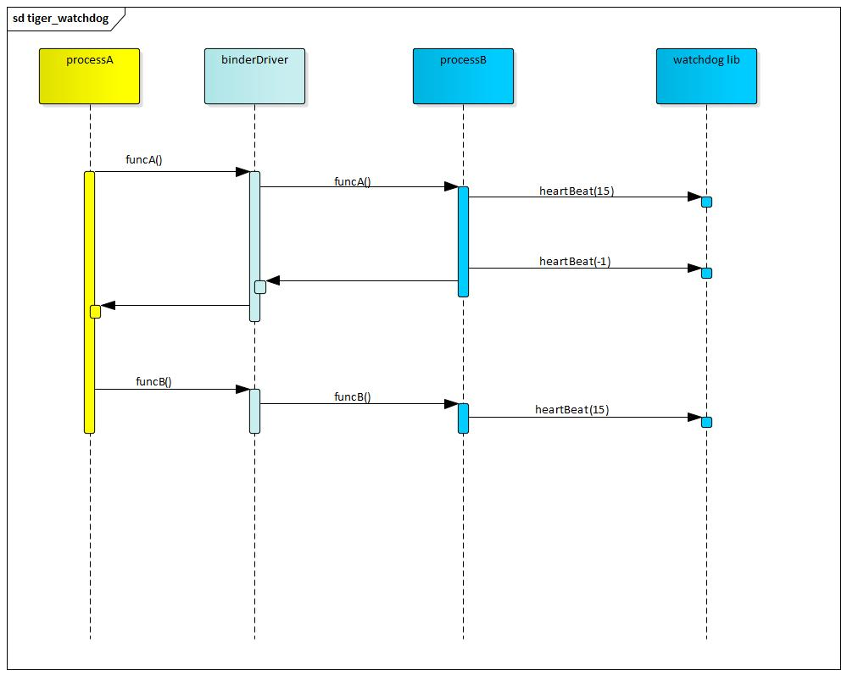
Timeout duration
(predefined)
Stuck state
heartbeat(-1)
Kill(SIGABRT)

Slide 13
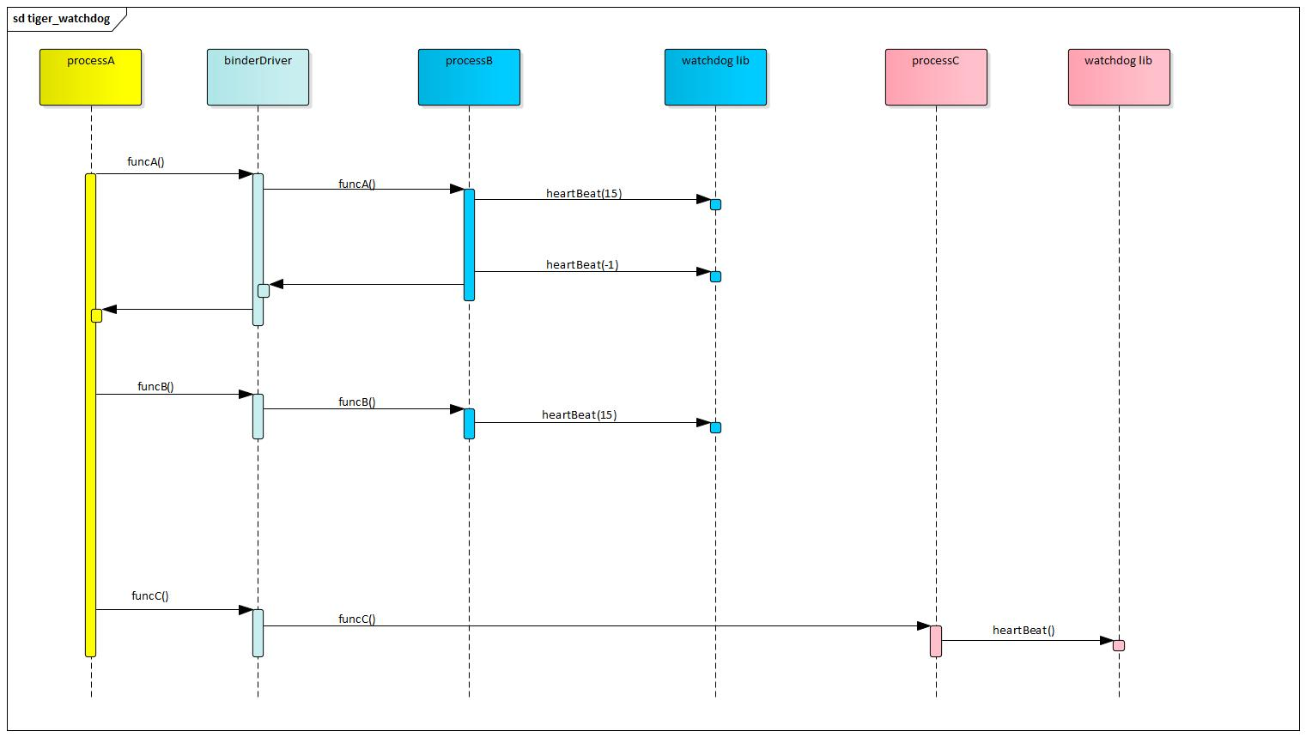
Timeout duration
(predefined)
Stuck state
heartbeat(-1)
Kill(SIGABRT)

Slide 14
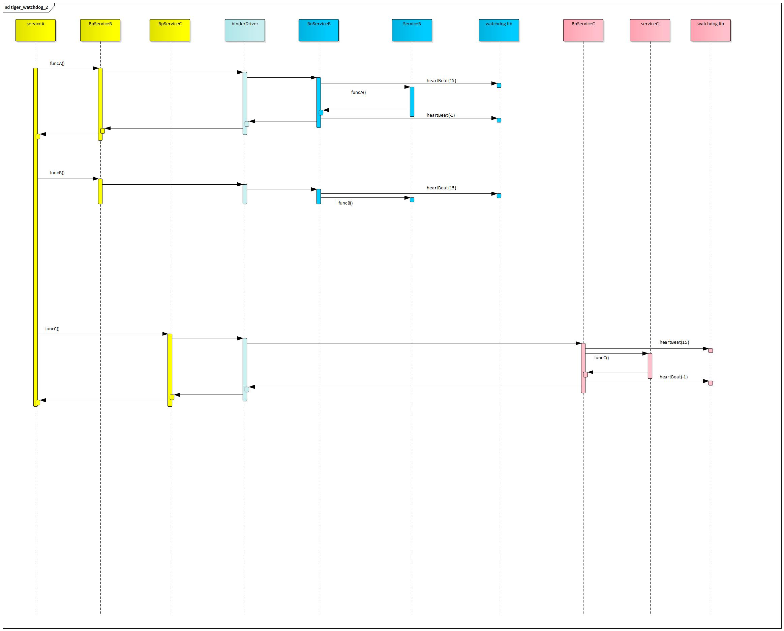
heartbeat(-1)
Stuck state
Kill(SIGABRT)

Slide 15
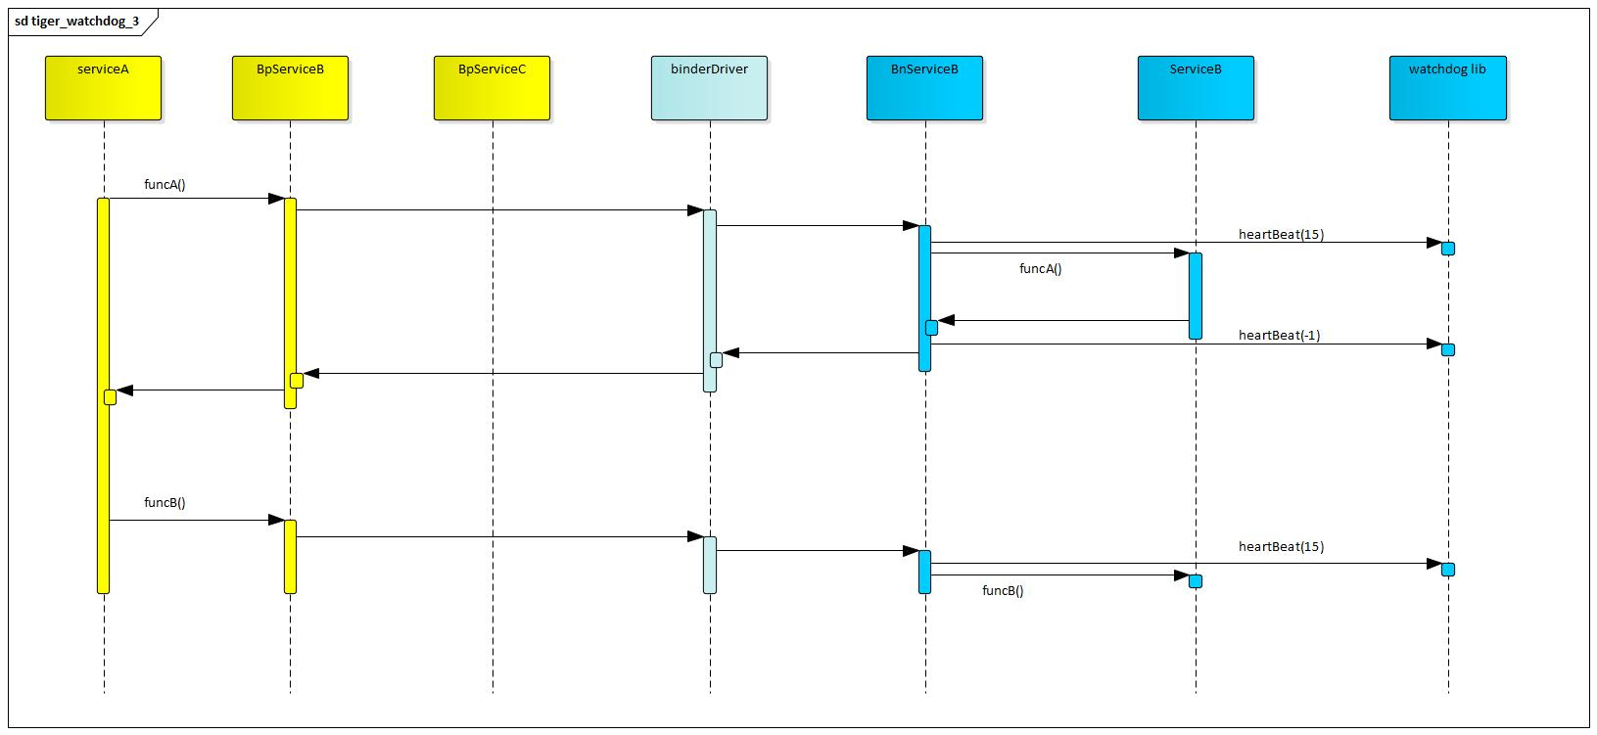
Timeout duration
(predefined)
heartbeat(-1)
Stuck state
Kill(SIGABRT)

Slide 16
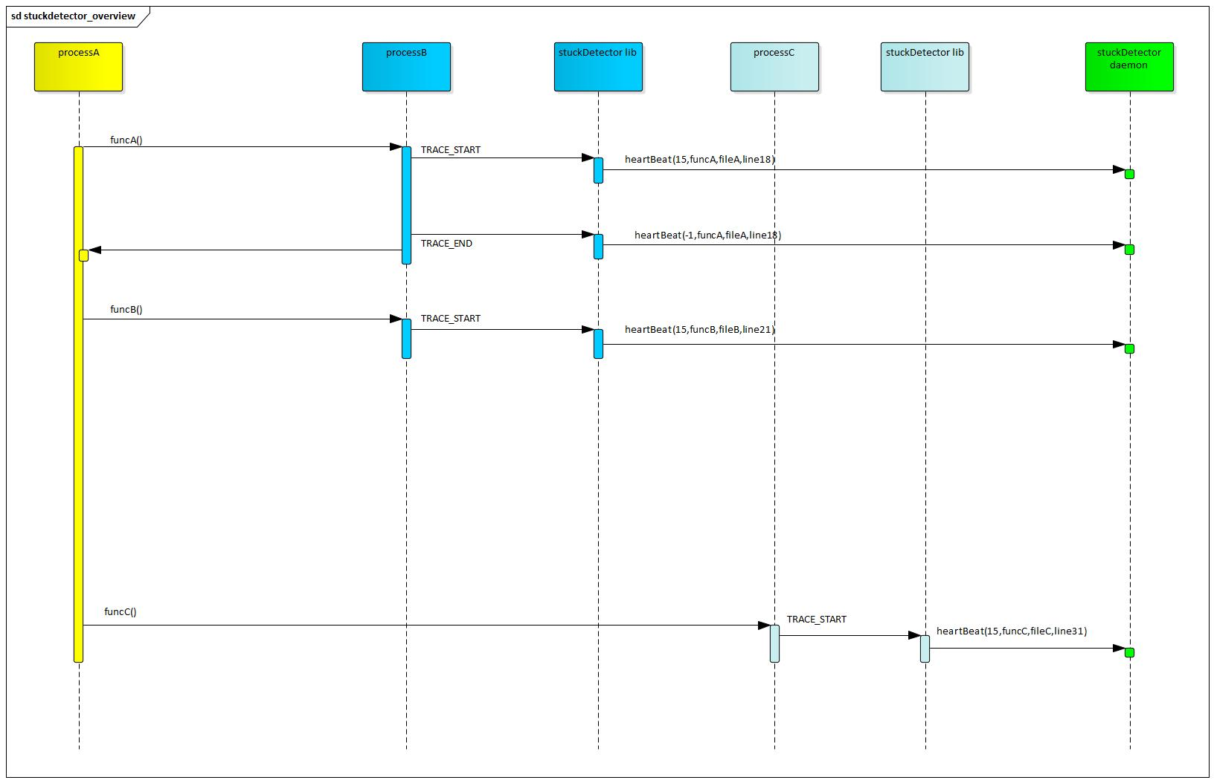
Timeout duration
(predefined)
Stuck state
TRACE_END
heartbeat(-1,funcC,fileC,line21)
Report stuck at:
funcC, fileC, line21
Kill(SIGABRT)

Slide 17
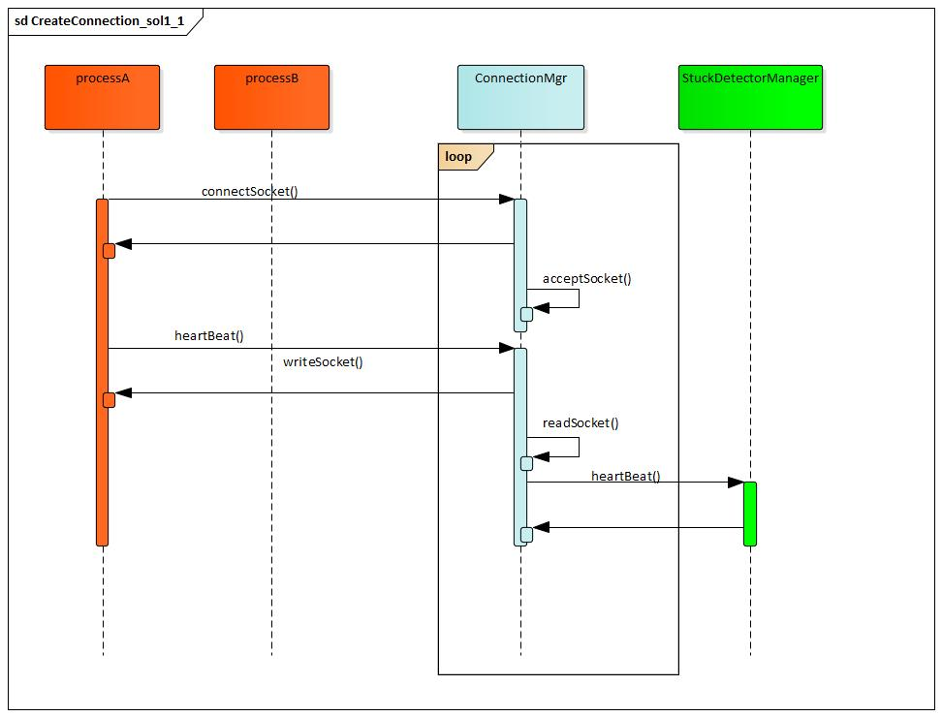
connectSocket()
Request is blocking.
ConnectionMgr is busy

Slide 18
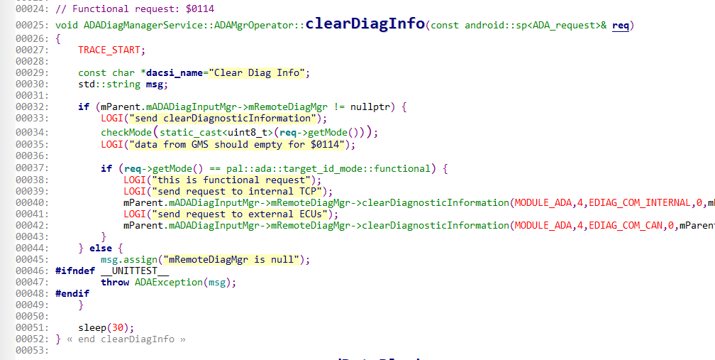
Add TRACE_START
Simulate Delay

Slide 19
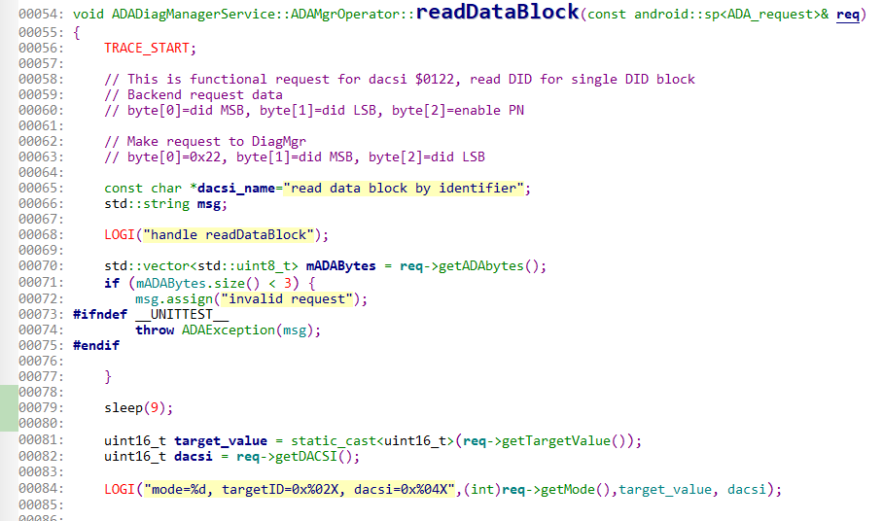
Add TRACE_START
Simulate Delay

